Slide 1
Statistics: Displaying Data
EQ: Compare dot plots to stem and leaf plots?

Slide 2
First 5

Slide 3
LHS Brainstorm: What are some different ways we display numbers/data?

Slide 4
24
7
30
Topic: Displaying data
Compare dot plots to stem and leaf plots
How can we display data?
Data can be displayed in many different ways and the most appropriate way will depend on the type and amount of data, and what we are using it for.
Types of graphs that we use in Yr 7 include:
Dot plots
Stem and leaf plots
Bar/column graphs
histograms
And in HASS/science you will be using line graphs.
WICOR

Slide 5
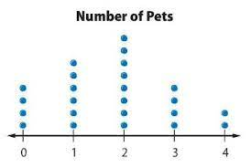
24
7
30
Topic: Displaying data
Compare dot plots to stem and leaf plots
What are dot plots?
A dot plot is a graph where each data value is represented by a dot, placed above a scale. They are most useful in plotting small sets of discrete numerical data.
WICOR

Slide 6

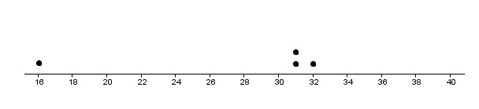
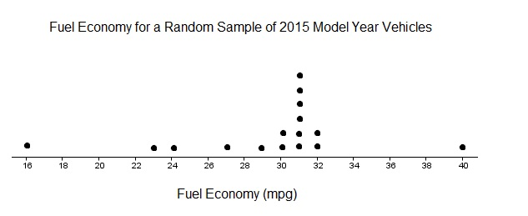
24
7
30
Topic: Displaying data
Compare dot plots to stem and leaf plots
What are the steps to creating a dot plot?
Identify the lowest and highest values in your data set and make these the start and end points on your scale
Complete the plot by making a dot for each of the data values in the set.
Be careful to space them evenly!
Add an axis label and title
WICOR

Slide 7
LHS Practise
The minimum daily temperatures (rounded) for Perth in July 2020 were:
{ 12, 4, 7, 12, 10, 13, 12, 11, 6, 5, 5, 7, 11, 12, 9, 13, 12, 7, 4, 5, 5, 8, 15, 4, 5, 14, 14, 12, 12, 7, 9 }
Create a dot plot to display this data set.
1. Find the lowest and highest values and create a scale

Slide 8
LHS Practise
The minimum daily temperatures (rounded) for Perth in July 2020 were:
{ 12, 4, 7, 12, 10, 13, 12, 11, 6, 5, 5, 7, 11, 12, 9, 13, 12, 7, 4, 5, 5, 8, 15, 4, 5, 14, 14, 12, 12, 7, 9 }
Create a dot plot to display this data set.
Find the lowest and highest values and create a scale.
Put a dot for each value above the scale – remember to space them evenly.
It can help to cross them off as you add them to your graph.

Slide 9
LHS Practise
The minimum daily temperatures (rounded) for Perth in July 2020 were:
{ 12, 4, 7, 12, 10, 13, 12, 11, 6, 5, 5, 7, 11, 12, 9, 13, 12, 7, 4, 5, 5, 8, 15, 4, 5, 14, 14, 12, 12, 7, 9 }
Create a dot plot to display this data set.
Find the lowest and highest values and create a scale.
Put a dot for each value above the scale – remember to space them evenly
Add a title for the graph and the axis

Slide 11
Helpful videos
Creating a dot plot in excel:
https://www.youtube.com/watch?v=XJj6kAveI1I
Creating a dot plot in Google sheets: https://www.youtube.com/watch?v=5AeXIqeNKgg
Just creating a plot by hand:
https://www.youtube.com/watch?v=Iq6CpefZwAk

Slide 12
What could make creating a dot plot faster?
Creating a frequency table!
This means that you have the number of dots for each value as a total.

Slide 13
24
7
30
Topic: Displaying data
Compare dot plots to stem and leaf plots
What is a stem and leaf plot?
A stem and leaf can be made from 2 digit or 3 digit numerical data and are used for large data sets. They are useful because it can group data, while still showing all of the individual values.
The stem and leaf plot consists of two parts – a stem and a leaf. Each data value is divided into 2 parts so that it can be plotted like this.
For example a score of 32 can be written as:
Stem | Leaf
3 | 2
WICOR

Slide 14
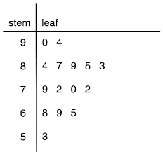
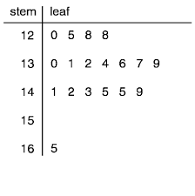
Example 1 Key 9 I 4 = 94
Example 2
Key 19 I 4 = 194

Slide 15
24
7
30
Topic: Displaying data
Compare dot plots to stem and leaf plots
What are the steps to making a Stem and leaf plot?
Gather your data
Decide on the stem you will be using for your plot and make a key
e.g. Key 5 I 4 = 54
Draw your stem and leaf axis
Stem Leaf
WICOR

Slide 16
24
7
30
Topic: Displaying data
Compare dot plots to stem and leaf plots
What are the steps to making a Stem and leaf plot?
4. List the stems down the page in ascending order (usually tens)
5. Write in the key you are using beside the stem and leaf plot
6. Work through your data set and add the leaf for each result
Stem
Leaf
Key 5 I 4 = 54
0
1
2
3
4
5
WICOR

Slide 17
24
7
30
Topic: Displaying data
Compare dot plots to stem and leaf plots
4. List the stems down the page in ascending order (usually tens)
5. Write in the key you are using beside the stem and leaf plot
6. Work through your data set and add the leaf for each result. Order the leaves in ascending order (going from 0-9 left to right)
What are the steps to making a Stem and leaf plot?
Stem
Leaf
Key 5 I 4 = 54
0
1
2
3
4
5
0 1 4
0 3 5 5
5 8
1 6 7 8
0 2 5 9 9
1
WICOR

Slide 18
We do:
The maximum daily temperatures (rounded) for Perth in July 2020 were:
{ 31,31,30,26,22,20,19,20,23,27,29,}
Create a stem and leaf plot to display this data set.

Slide 19
24
7
30
Topic: Displaying data
Compare dot plots to stem and leaf plots
Gather your data
Decide on the stem you will be using for your plot and make a key
e.g. Key 5 I 4 = 54
Draw your stem and leaf axis
Stem Leaf
WICOR

Slide 20
24
7
30
Topic: Displaying data
Compare dot plots to stem and leaf plots
4. List the stems down the page in ascending order (usually tens)
5. Write in the key you are using beside the stem and leaf plot
6. Work through your data set and add the leaf for each result. Order the leaves in ascending order (going from 0-9 left to right)
What are the steps to making a Stem and leaf plot?
Stem
Leaf
Key 5 I 4 = 54
0
1
2
3
4
5
9
0 0 2 3 6 7 9
0 1 1
WICOR

Slide 21
Helpful videos
Making a stem and leaf plot in Excel: https://www.youtube.com/watch?v=bsYmXapWDk8
Making a stem and leaf plot by hand:
https://www.youtube.com/watch?v=LhoWhWu-g30&list=RDCMUCQRcG9o2pBhMX9muqLYImmw&index=1

Slide 22
Your turn! LHS
Put the following sets of data into either a dot plot or a stem and leaf plot:
Number of pets students have:
{ 2, 3, 5, 0, 1, 0, 1, 2, 3, 4, 0, 1, 1, 2, 6, 2, 0, 1, 2 }
Height of Yr 8 students:
{ 145, 140, 160, 135, 135, 145, 143, 162, 145, 135, 150, 145, 140, 140, 145, 125, 140, 141, 150, 152, 155, 140, 145, 135, 135 }

